Slide 1
LOOP CONTINUED
Shubham Dhungana

Slide 2
Terminating Loops
Counter-controlled loops - a loop controlled by a counter variable, generally where the number of times the loop will execute is known ahead of time
Event-controlled loops - loops where termination depends on an event rather than executing a fixed number of times

Slide 3
Counter-Controlled Loops
Generally with for loops
Can generally infer number of repetitions from code
Examples:
  read 5 numbers
  print 7 items
  sort n items

Slide 4
Event-Controlled Loops
Generally with while, do-while loops
Can’t infer number of repetitions from program
Examples:
  read until input ends
  read until a number encountered
  search through data until item found

Slide 5
Parts of Loop
Initialization - commands to set up loop (set counter to initial value, etc.)
Terminating condition - logical condition that is checked to terminate loop
Body of loop - commands repeated
  action(s) - statements to repeat
  update(s) - statements to update values associated with loop (counters, etc.)

Slide 6
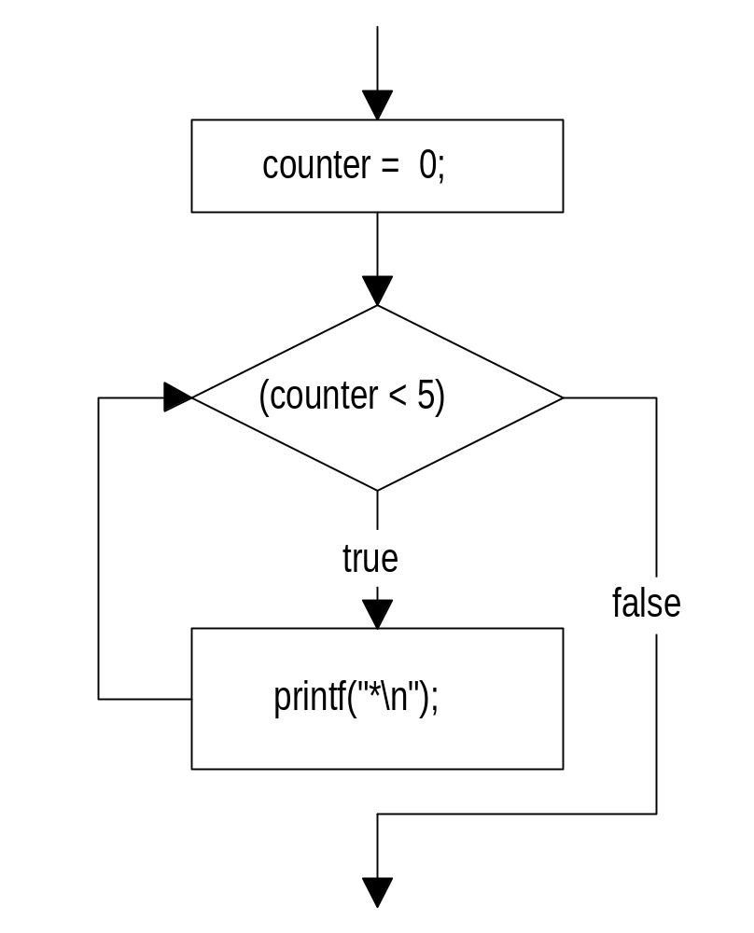
Importance of Update
What if command
counter++;
left out?
Counter never becomes >= 5.
Termination Condition never met.

Slide 7
Infinite Loops
Loop starts but termination condition never met:
  you forget to increase counter
  user never enters terminating data item
  etc.
Results
  program may stop (doing nothing repeatedly)
  computer may repeatedly print some data out

Slide 8
Termination Conditions in C
Loops in C always continue when the termination condition is true and end when the condition is false
Conditions can be rephrased if needed (positive termination conditions can be negated)
Condition only checked at fixed points (does not have to hold true during body)

Slide 9
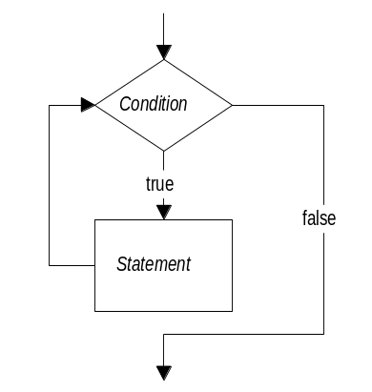
Pretest Loop: While
Syntax:
  while (condition)
  statement;
Corresponds to:
  if (!condition) DONE
  statement
  if (!condition) DONE
  statement
  ...

Slide 10
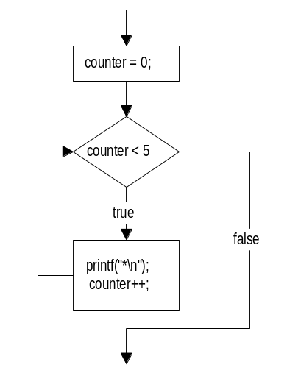
Example of While
int counter = 0;
while (counter < 5) {
printf(“*\n”);
counter++;
}
single statement is compound

Slide 11
Executing More Than One Stmt
In C, loops repeat one statement
Generally we always use a compound statement as that statement:
  while (condition) {
  /* body */
  }
Useful even when body has one or no statements

Slide 12
Empty Statements and Loops
What’s wrong with this?
  counter = 0;
  while (counter < 5);
  {
  printf(“*\n”);
  counter++;
  }
Note the ; after the condition in the while, its an empty statement (which is the body of the while), so the while is an infinite loop

Slide 13
Event-Controlled While
While loops are often used to test for the occurrence of events that terminate loops
Example:
  read in a set of numbers until a particular value is encountered
  along the way count the set of numbers and the total of the numbers
  print out the average of the numbers
  does not terminate after a fixed point

Slide 14
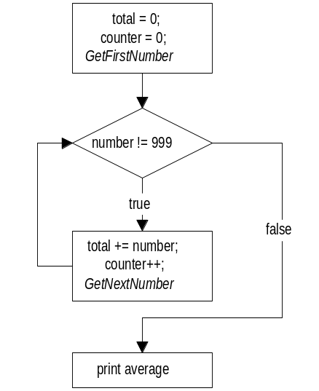
Calculate Average Loop

Slide 15
Calculate Average Code
total = 0;
count = 0;
printf(“Please enter first number: “);
scanf(“%d”,&number);
while (number != -999) {
total += number;
count++;
printf(“Please enter next number: “);
scanf(“%d”,&number);
}
printf(“Average is %.3f\n”,(float) total / count);

Slide 16
Using a Sentinel
The value -999 is sometimes referred to as a sentinel value
The value serves as the “guardian” for the termination of the loop
Often a good idea to make the sentinel a constant:
  #define STOPNUMBER -999
  while (number != STOPNUMBER) ...

Slide 17
Compound Conditions
Often the termination condition is compound:
ans = ‘N’;
while (!((ans == ‘Y’) || (ans == ‘y’))) {
printf(“Enter id# and salary: “);
scanf(“%d %f”,&id,&salary);
printf(“You entered id#%1d and salary $%.2f, Is this correct? (Y/N) “,id,salary);
scanf(“ %c”,&ans);
}

Slide 18
Making Sure Loop is Entered
Note in previous loop, we had to set variable ans to an initial value, ‘N’
This is because a while loop tests its condition before entering the loop, and if the condition is already false, the loop never executes
Sometimes it is useful to have a loop that always executes at least once

Slide 19
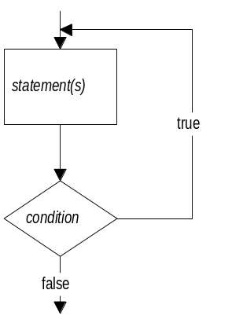
Posttest Loop: Do-While
Syntax:
do {
statement(s)
} while (condition);
Corresponds to:
  statement
  if (!condition) DONE
  statement
  if (!condition) DONE
  ...

Slide 20
Using the Do-While
do {
printf(“Enter id# and salary: “);
scanf(“%d %f”,&id,&salary);
printf(“You entered id#%1d and salary $%.2f, Is this correct? (Y/N) “ ,id,salary);
scanf(“ %c”,&ans);
} while (!((ans == ‘Y’) || (ans == ‘y’)));
Loop always executes at least once

Slide 21
Programs with Menus
A)dd part to catalog
R)emove part from catalog
F)ind part in catalog
Q)uit
Select option: A
<interaction to add a part>
A)dd part to catalog
R)emove part from catalog
F)ind part in catalog
Q)uit
Select option: <next option>

Slide 22
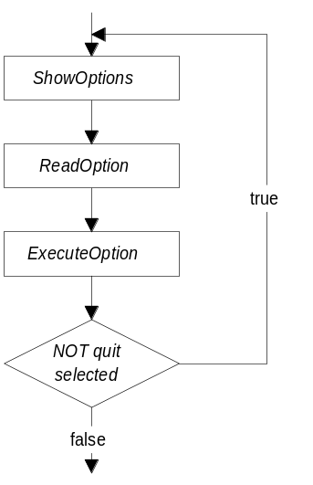
Menu Loop
do {
showOptions();
printf(“Select
option:“);
scanf(“ %c”,&optn);
execOption(optn);
while (!(
(optn == ‘Q’) || (optn == ‘q’)));

Slide 23
Menu Options
void showOptions() {
printf(“A)dd part to catalog\n”);
printf(“R)emove part from
catalog\n”);
printf(“F)ind part in catalog\n”);
printf(“Q)uit\n”);
}

Slide 24
Executing Options
void execOption( char option ) {
switch (option) {
case ‘A’: case ‘a’: addPart(); break;
case ‘R’: case ‘r’: delPart(); break;
case ‘F’: case ‘f’: fndPart(); break;
case ‘Q’: case ‘q’: break;
default: printf(“Unknown option
%c\n”,option); break;
}
}

Slide 25
While vs Do-While
Differences
  where condition tested:
    while (first) - may execute 0 times
    do-while (last) - must execute at least one time
Similarities
  one statement executed
  initialization before loop
  update during loop

Slide 26
Pretest Loop: For
Initialization included in loop header
Update included in loop header
Header also includes update
Syntax:
  for ( init ; condition ; update )
  statement;
Generally for loops expected to execute fixed number of times (counter-controlled)

Slide 27
For Example - Sum of 1 to N
printf(“Number to sum to: “);
scanf(“%d”,&N);
total = 0;
for (I = 1; I <= N; I++)
total += I;
/* total is now 1 + 2 + … + N */

Slide 28
For Example - Max of N Scores
printf(“Number of students: “);
scanf(“%d”,&NumStudents);
for (I = 0; I < NumStudents; I++) {
printf(“Enter student score %d: “);
scanf(“%d”,&score);
if (score > max)
max = score;
}
/* max is highest score entered */

Slide 29
Directions of Counting
for (I = 10; I >= 1; I--)
printf(“%d…\n”,I);
printf(“0 BLASTOFF!\n”);
printf(“Enter start, end, inc values: “);
scanf(“%d%d%d”,&lstart,&lend,&linc);
for (I = lstart;
((linc < 0) && (I < lend)) ||
((linc > 0) && (I > lend));
I += linc)
printf(“%d\n”,I);

Slide 30
Nesting Loops
It is often useful to have a loop within a loop (called nested loops)
For example:
  printf(“Max N! to print: “);
  scanf(“%d”,&N); /* 1 */
  for (I = 1; I <= N; I++) { /* 2 */
  fact = 1; /* 3 */
  for (J = 2; J <= I; J++) /* 4 */
  fact *= J; /* 5 */
  printf(“%d! = %d\n”,I,fact); /* 6 */
  }

Slide 31
Tracing Nested Loops
Stmt N I J fact output
1 4
2 1
3 1
4 2
6 1! = 1
2 2
3 1
4 2
5 2
4 3
6 2! = 2
2 3
3 1
4 2
5 2
Stmt N I J fact output
4 3
5 6
4 4
6 3! = 6
2 4
3 1
4 2
5 2
4 3
5 6
4 4
5 24
4 5
6 4! = 24
2 5

Slide 32
More Efficient Implementation
printf(“Max N! to print: “);
scanf(“%d”,&N);
fact = 1;
for (I = 1; I <= N; I++) {
fact *= I;
printf(“%d! = %d\n”,I,fact);
}
But why does this work?

Slide 33
Another Nesting Example
How to print:
  ******
  *****
  ****
  ***
  **
  *
for (I = 6; I >= 1; I--) {
for (J = 1; J <= I; J++)
printf(“*”);
printf(“\n”);
}
Could have 6 be a variable

Slide 34
More Complex Nesting
How to print:
  ***********
  *********
  *******
  *****
  ***
  *
for (I = 0; I <= 5; I++) {
for (J = 0; J < I; J++)
printf(“ “);
for (J = 0;
J < (11 - 2 * I);
J++)
printf(“*”);
printf(“\n”);
}
Note 2 (sequential) inner loops

Slide 35
Another Nesting Example
Size: 5
*****
****
***
**
*
Size: 3
***
**
*
Size: 0
do {
printf(“Size: “);
scanf(“%d”,&Size);
if (Size > 0) {
for (I = Size; I >= 1; I--) {
for (J = 1; J <= I; J++)
printf(“*”);
printf(“\n”);
}
}
} while (Size > 0);

Slide 36
Nesting and Functions
With deep nesting its often a good idea to have inner loops in separate functions
do {
printf(“Size: “);
scanf(“%d”,&Size);
drawTri(Size);
} while (Size > 0);
void drawTri (int N)
{
int I;
int J;
if (N > 0) {
for (I = N; I >= 1; I--)
{
for (J = 1; J <= I;
J++)
printf(“*”);
printf(“\n”);
}
}
}

Slide 37
break statement
The break statement can be used to halt a loop, though it is generally better to use a flag to signal loop should end
  total = 0;
  do {
  scanf(“%d”,&num);
  if (num < 0) break; /* Loop ends */
  } while (num != 0);

Slide 38
Flags
Better to use a flag variable - a variable that is set to a value when a condition occurs
  total = 0;
  done = 0; /* done is set to 0 state */
  do {
  scanf(“%d”,&num);
  if (num < 0) done = 1; /* done 1 */
  } while ((num != 0) && (!done));

Slide 39
continue statement
A continue statement says jump to the next end of the statement list
Example:
  for (I = 0; I < 100; I++) {
  if ((I % 2) == 1) continue;
  printf(“%d is even”,I);
  }
Again, stylistically, better not to use

Slide 40
Avoiding continue
Can generally use an if to avoid a continue:
  for (I = 0; I < 100; I++) {
  if ((I % 2) == 1) continue;
  printf(“%d is even”,I);
  }
  becomes
  for (I = 0; I < 100; I++) {
  if (!((I % 2) == 1))
  printf(“%d is even”,I);
  }

